Slide 1
Tableau

Slide 2


Slide 3



Slide 4
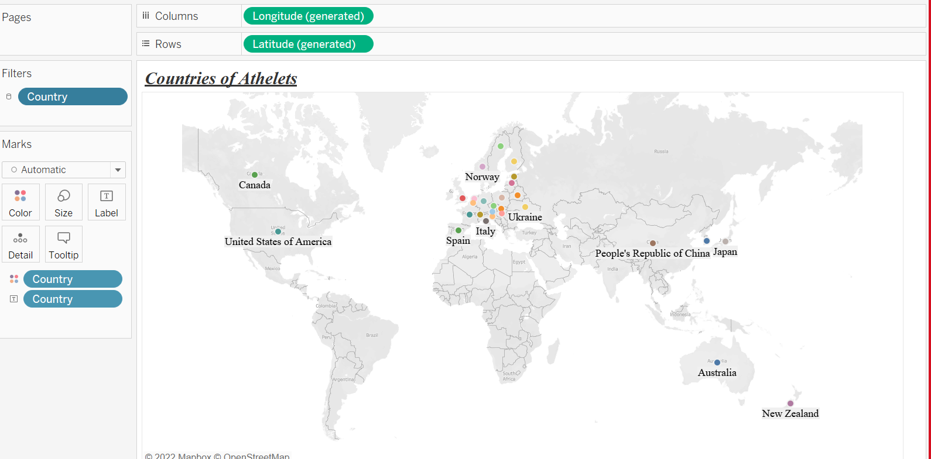
Countries participated

Slide 5
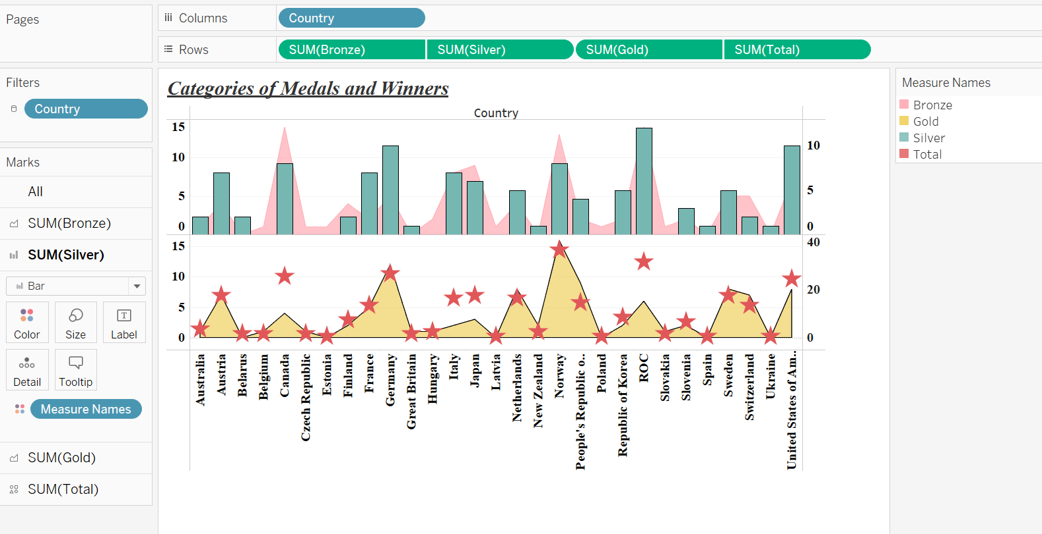
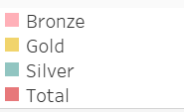
Categories of medals

Slide 6
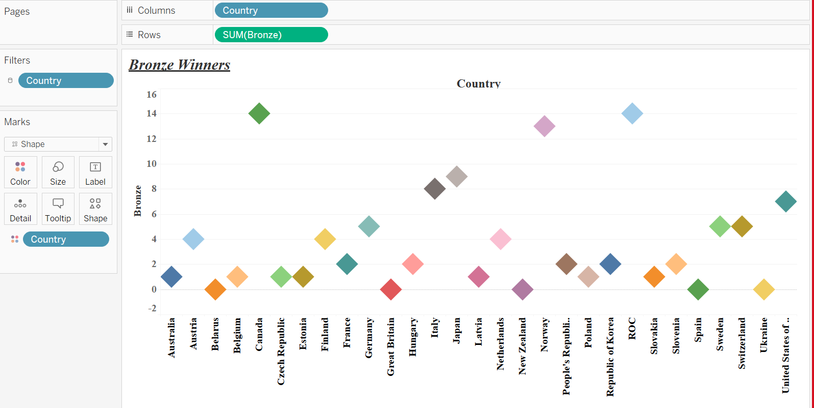
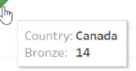
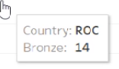
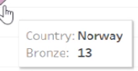
Bronze winners
Top 3 Bronze winners: Canada ,ROC , Norway

Slide 7
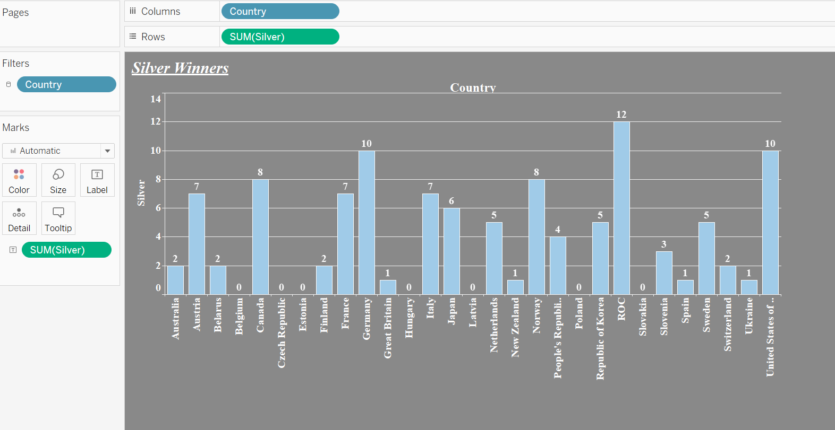
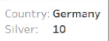
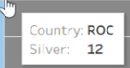

Silver winners
Top 3 silver winners
1.ROC
2.Germany
USA

Slide 8
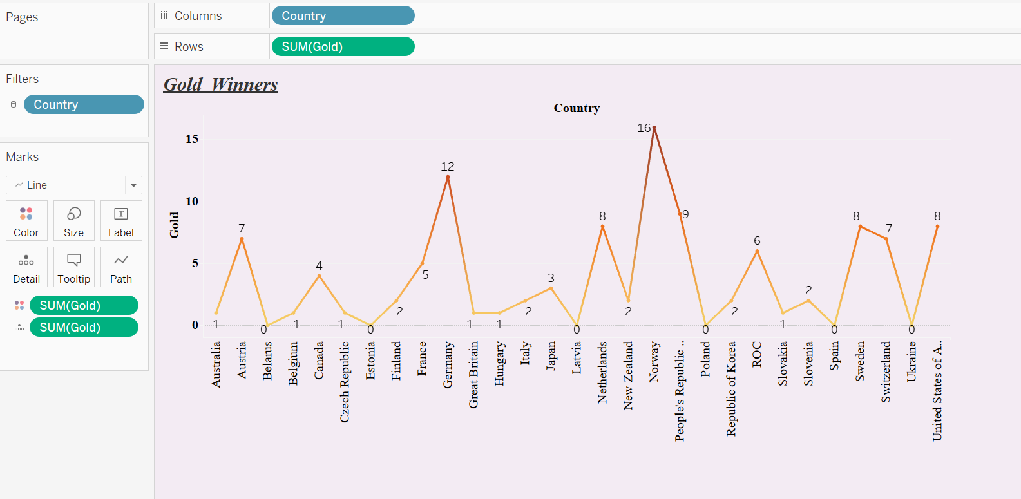
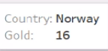
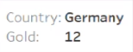

Gold winners
Top 3 gold winners
1.Norway
2.Germany
3.People’s Republic of china

Slide 9
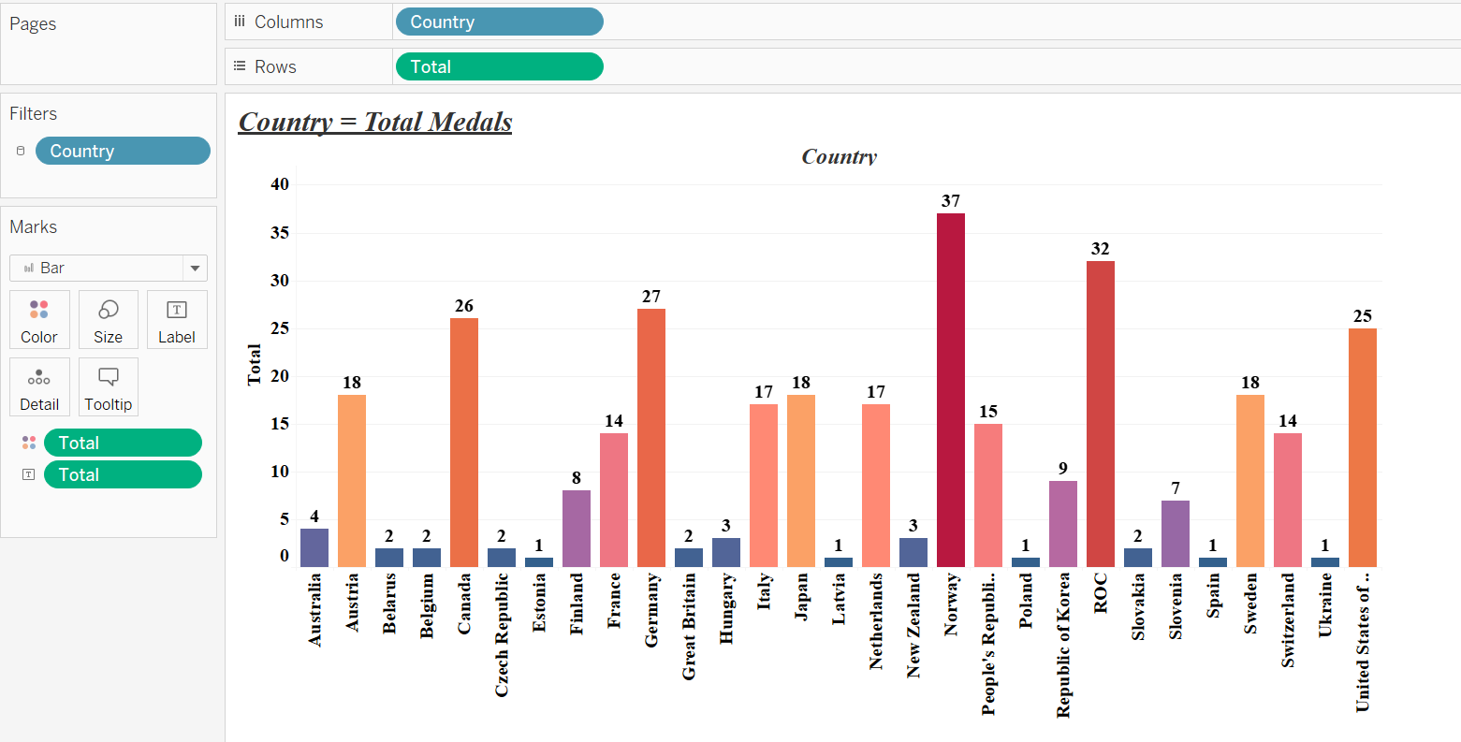
Total medals won by each country.

Slide 10
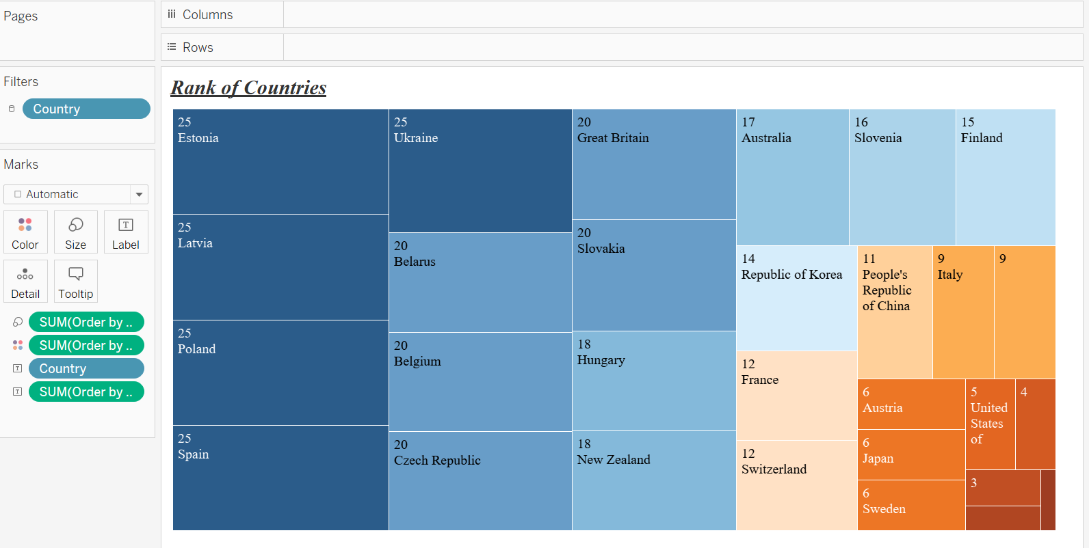
Rank of countries
Top 5 countries
Norway
ROC
Germany
Canada
USA

Slide 11
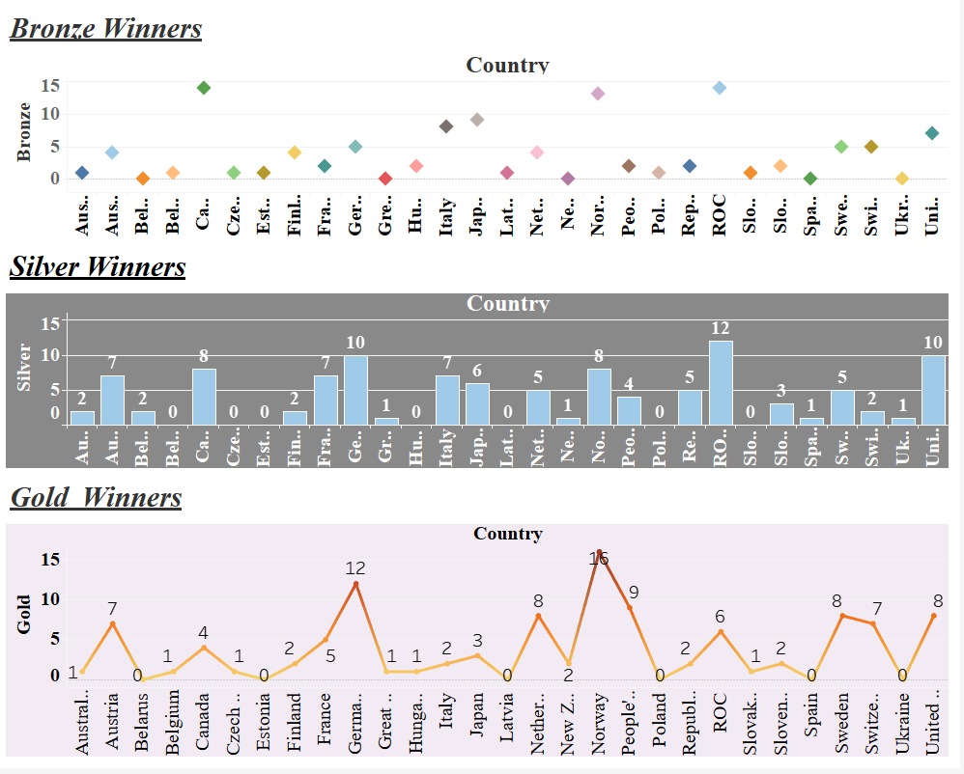
Comparison of medals winners

Slide 12
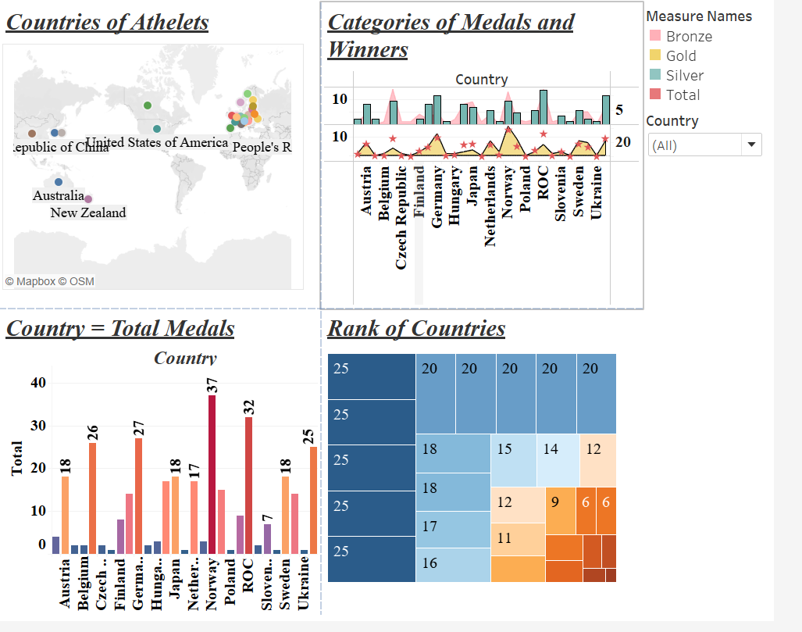
Beijing Winter Olympic Medals

Slide 13
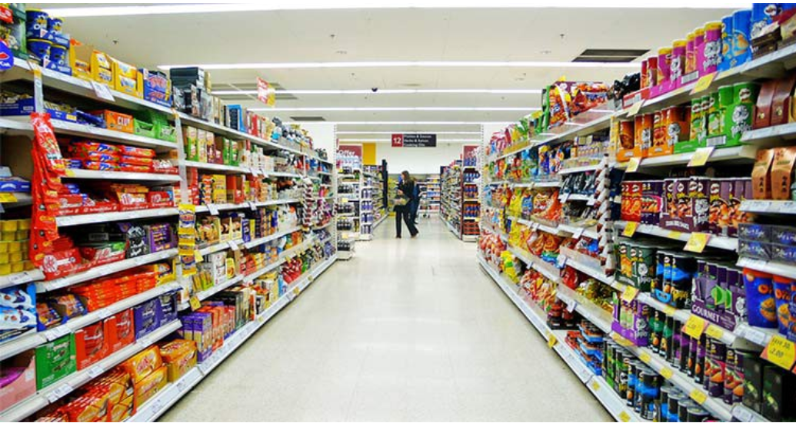
Supermarket sales

Slide 14
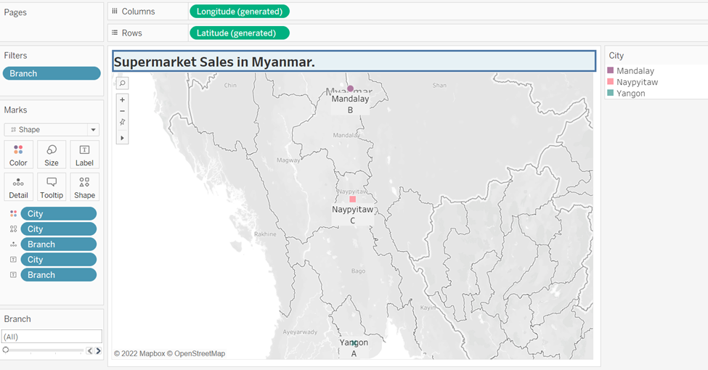
The dataset explores data of supermarkets located in Myanmar.
Myanmar is located in the western region of Southern Asia.
Naypyitaw is located North of Yangon and South of Mandalay.
Yangon is located south of Naypyitaw. Mandalay is located North of Naypyitaw.
Yangon is the largest city, followed by Mandalay then Naypyitaw.

Slide 15
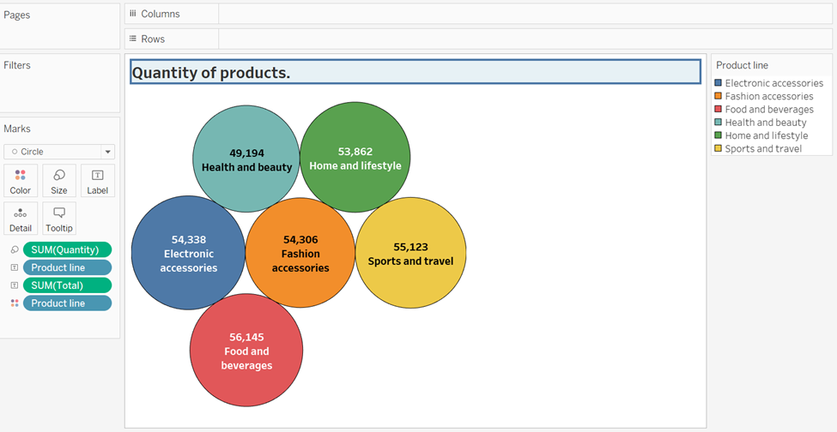
Prices of quantity available in specific product.
([Unit price*quantity]+[tax])

Slide 16
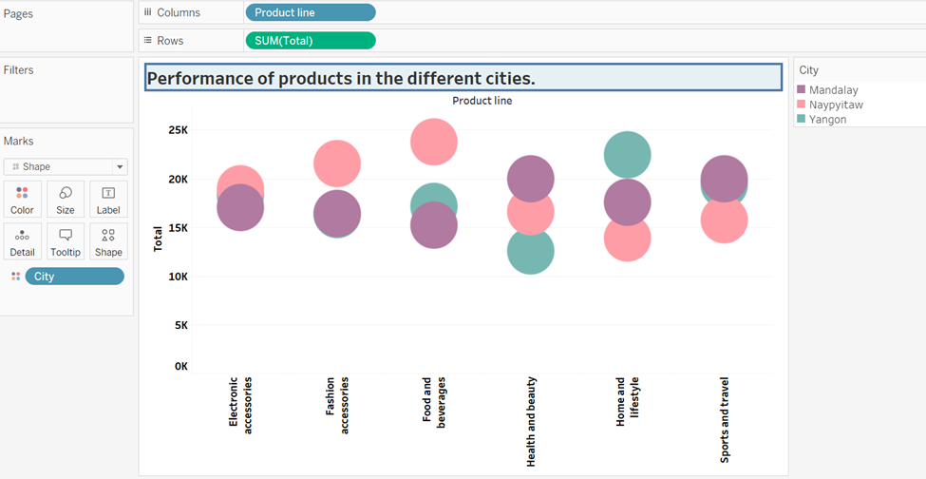
A visual on the performance of products as per the different cities.
In Mandalay, the leading product is sports and travel.
In Naypyitaw, the leading product is food and beverages
In Yangon the leading product is home and lifestyle.

Slide 17
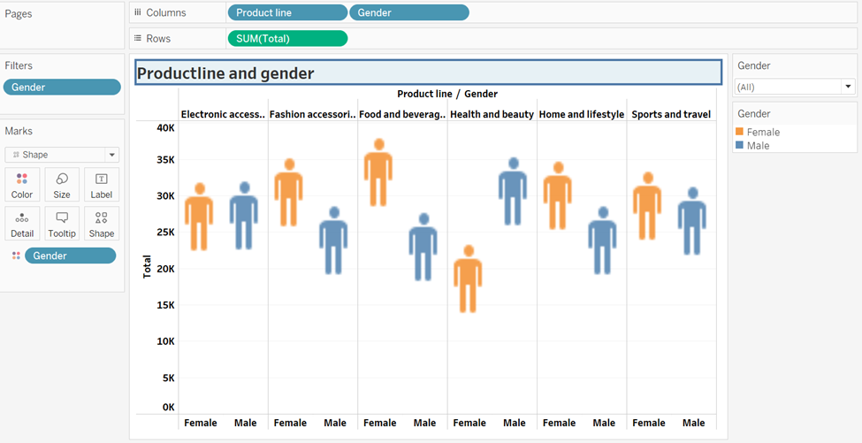
Comparison the product line and the different gender
In the electronic accessories it can be noted that both genders are slightly equal with female having 8.392% and male having 8.433%.
In health and beauty, male are seen to have the highest contribution of 9.485% out of 15.232%.
Food and beverages are seen to have a high contribution of female to male.

Slide 18
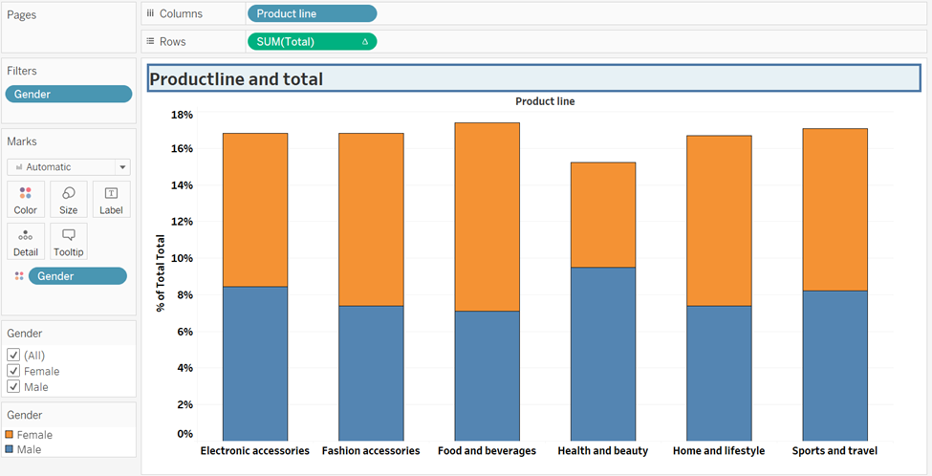
Comparing the trend of cost of goods of the different products.

Slide 19
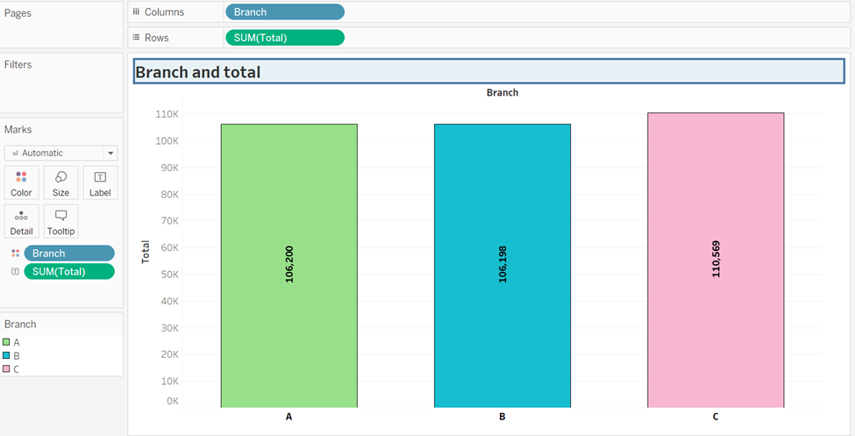
Comparing the three branches
The supermarket has three branches: A, B and C.
C appears to have the highest total followed by A and finally B.

Slide 20
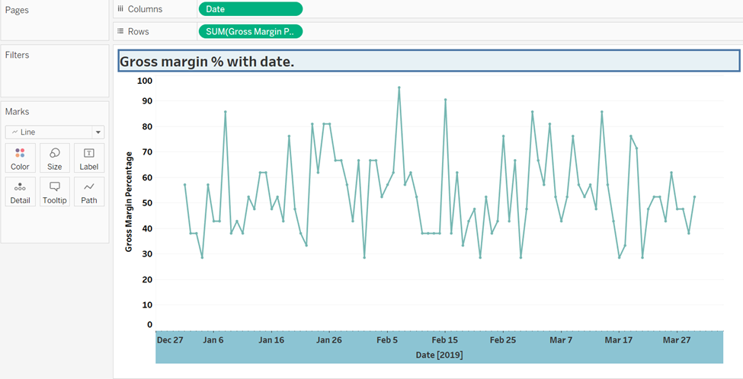
Gross Margin Percentage measures the performance of the business.
The Gross Margin Percentage is seen to decline from January to February in all the branches.
Between February and March the Gross Margin Percentage is seen to rise across all branches.

Slide 21
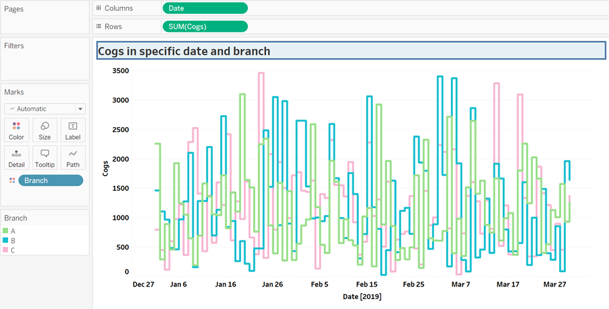
Trend in cost of goods sold.
With the graph of cost of goods and time, we see that the same period Gross Margin Percentage was decreasing, the cost of goods were also decreasing which concludes that price was not the the cause of the decrease in GMP. The cost might be due to poor management.

Slide 22
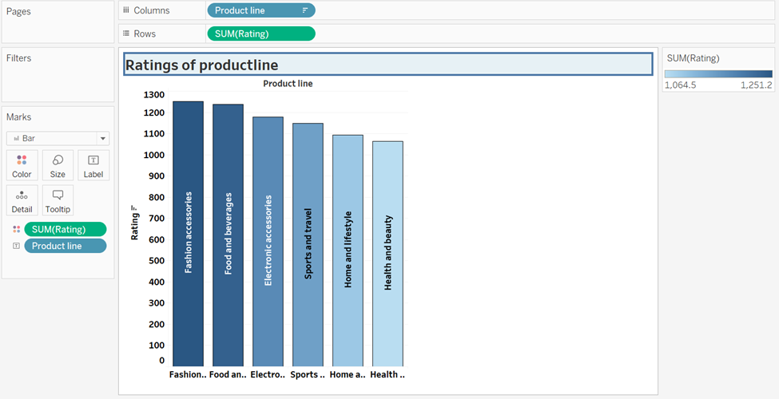
Rating of products in descending order.
The product with the highest rating
is fashion accessories - because high rating shows that the products is a good quality product.
The Second highest product in the gross income is food and
beverages.
The least rated product is health and beauty.

Slide 23
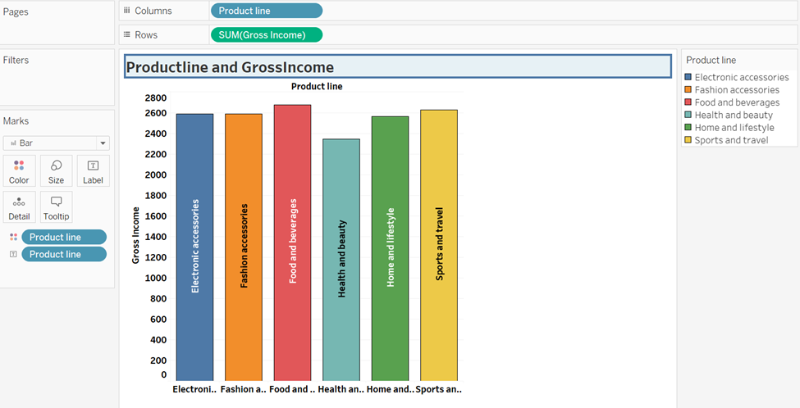
Gross income of products

Slide 24
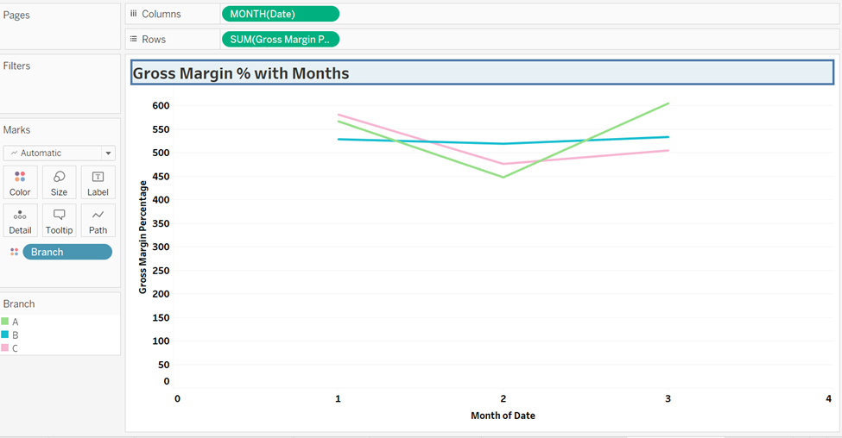
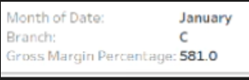
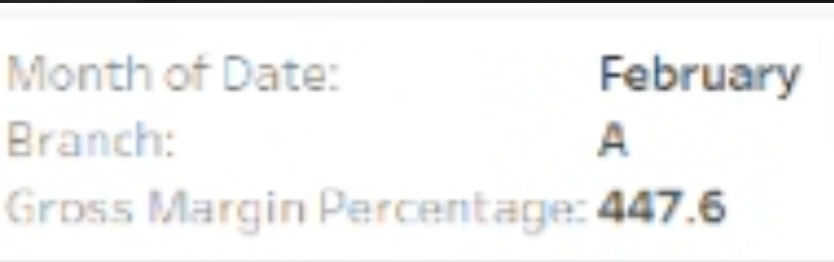
The Gross Margin Percentage trend
The Gross Margin Percentage is seen to decline from January to February in all the branches. Between February and March the Gross Margin Percentage is seen to rise across all branches.

Slide 25
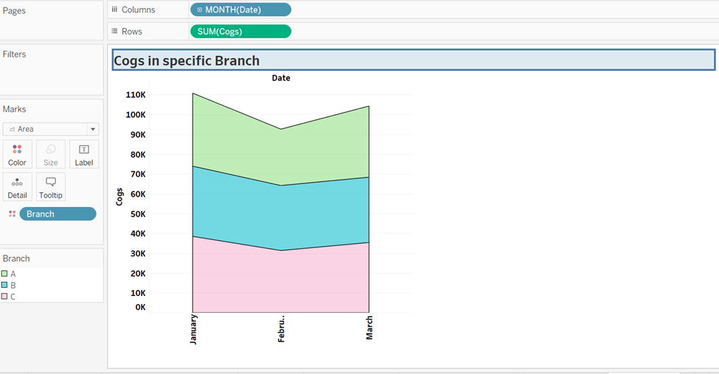
Cost of good sold in specific branch and month

Slide 26
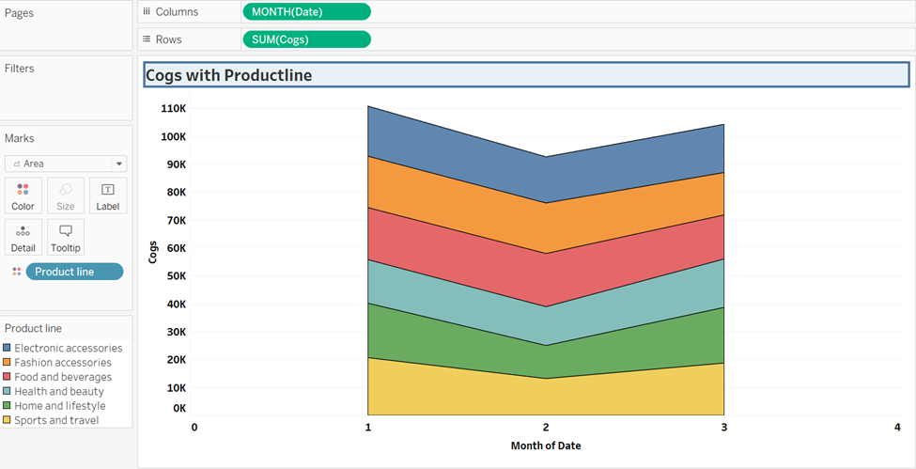
Cost of good sold in specific product

Slide 27
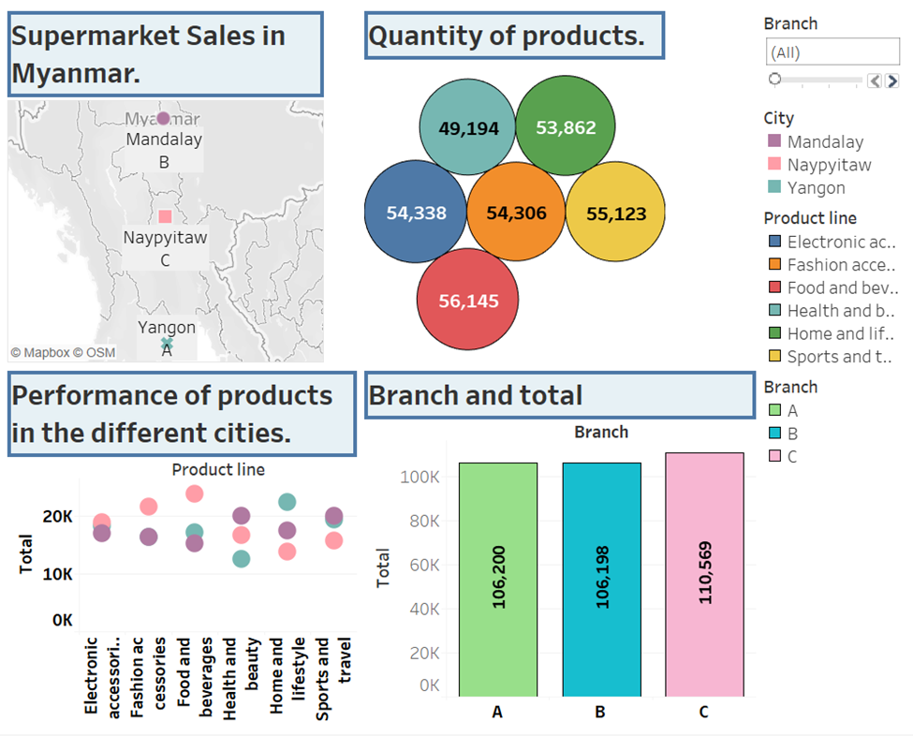
Supermarket sales in different cities and branches.

Slide 28
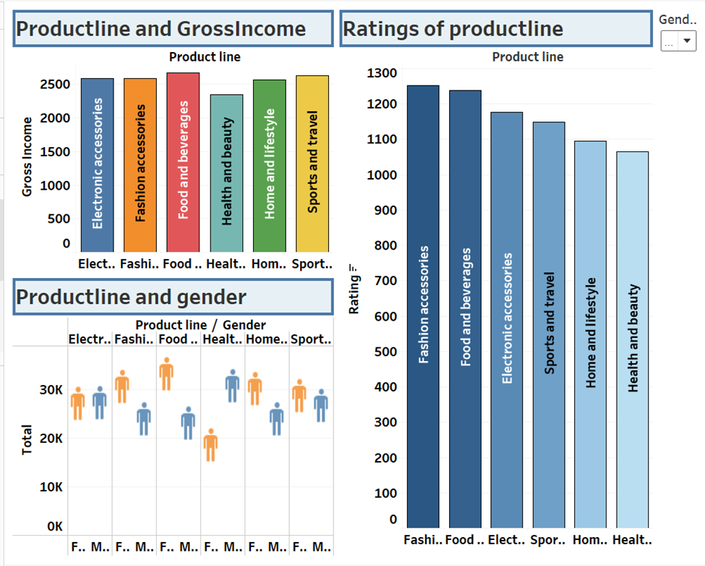
Product line of supermarket

Slide 29
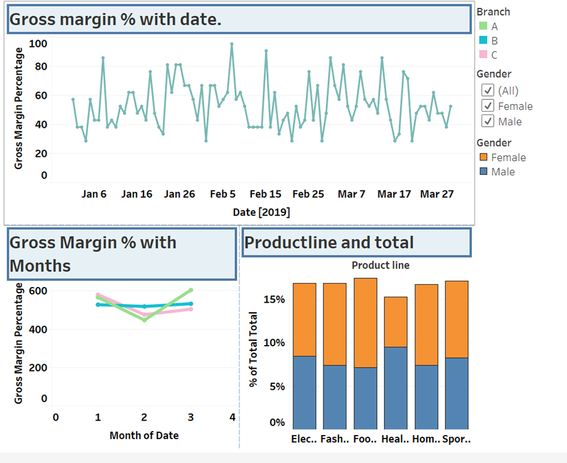
Gross margin % of products

Slide 30
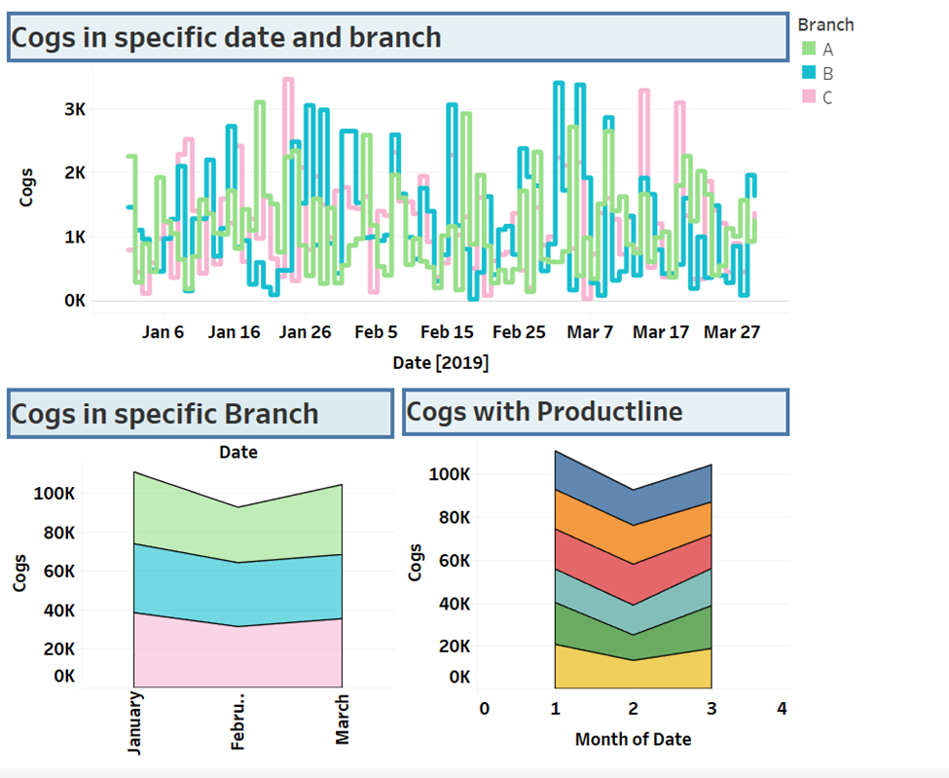
Cost of goods sold

Slide 31

DR.AMBEDKAR GROUP
Kendre Ganesh
Kokkari Charanraj
Putti Lakshmi Mounika
Pamarthi Pavani
Harshitha Kuchimanchi

